Slide 1
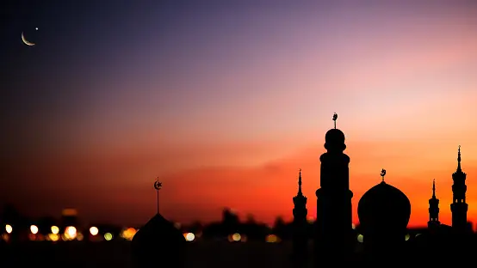


EID MUBARAK

